Slide 1


By Ateeq, Boaz, Dan, Manish, Nanda Mentor: Srdjan

Slide 2
Planned Features
Must have | Should Have | Nice to have
Randomly generate every next level​ ​ Scrolling background, with decreasing velocity as user gets to maximum height of each jump​ ​ Game must also randomly generate new enemies​ ​ Height must be tracked​ ​ Animation and Sprites​ | Blocks have time limit for being stood on before breaking​ ​ Player can attack enemies​ ​ Rising Lava Feature​ ​ Terrain obstacles​ ​ Player gets bonus points for collecting a trinket or some bonus item.​ ​ Enemies get more difficult as terrain difficulty increases. ​ ​ | Music and Sound Effects​ Different aesthetics at different checkpoints in the game.​ ​ Powerups​ ​ 2 player mode (race to stay on screen)​ ​ World High Score/Leaderboard​ ​ Changing the weapon based on terrain.​ ​ Moving platforms.​ Player Animations

Slide 3
Cut Features
Must have | Should Have | Nice to have
Randomly generate every next level​ ​ Scrolling background, with decreasing velocity as user gets to maximum height of each jump​ ​ Game must also randomly generate new enemies​ ​ Height must be tracked​ ​ Animation and Sprites​ | Blocks have time limit for being stood on before breaking​ ​ Player can attack enemies​ ​ Rising Lava Feature​ ​ Terrain obstacles​ ​ Player gets bonus points for collecting a trinket or some bonus item.​ ​ Enemies get more difficult as terrain difficulty increases. ​ ​ | Music and Sound Effects​ Different aesthetics at different checkpoints in the game.​ ​ Powerups​ ​ 2 player mode (race to stay on screen)​ ​ World High Score/Leaderboard​ ​ Changing the weapon based on terrain.​ ​ Moving platforms Player Animations

Slide 4
Ice Climber MDA Analysis
Mechanic
Dynamic
Aesthetic
Players feel rewarded.
The player can end up frustrated, or even very satisfied.
Player uses skill to defend themselves against enemies and allow them to climb faster
Player becomes strategic, uses theory and second guessing themselves
The game becomes more challenging, so more skilled players gain more satisfaction
Player can move and jump
Player must pass a level to advance to the next.
Player can attack enemies
Background can only move upwards
Obstacles in the background (like an icicle) can hurt the player
Player can navigate through obstacles and enemies and climb the mountain
The player can get stuck on harder levels, but they will push through it to advance.
Player can defend themselves while climbing the mountain
If a player falls through a hole on the bottom, the game will end.
Player must avoid obstacles while climbing the mountain

Slide 5
World Climber MDA Analysis
Mechanic
Dynamic
Aesthetic
Players feel rewarded.
The player can end up frustrated, or even very satisfied.
Player uses skill to defend themselves against enemies and allow them to climb faster
Player becomes strategic, uses theory and second guessing themselves
The game becomes more challenging with more enemies, so more skilled players gain more satisfaction
Player can move and jump
Player must pass a level to advance to the next.
Player cannot attack enemies
Background can only move upwards
Different types of enemies are present in each level
Player can navigate through obstacles and enemies and climb the mountain
The player can get stuck on harder levels, but they will push through it to advance.
Player need to avoid enemies while climbing the mountain
If a player falls through a hole on the bottom, the game will end.
Players will encounter new and more enemies per level

Slide 6
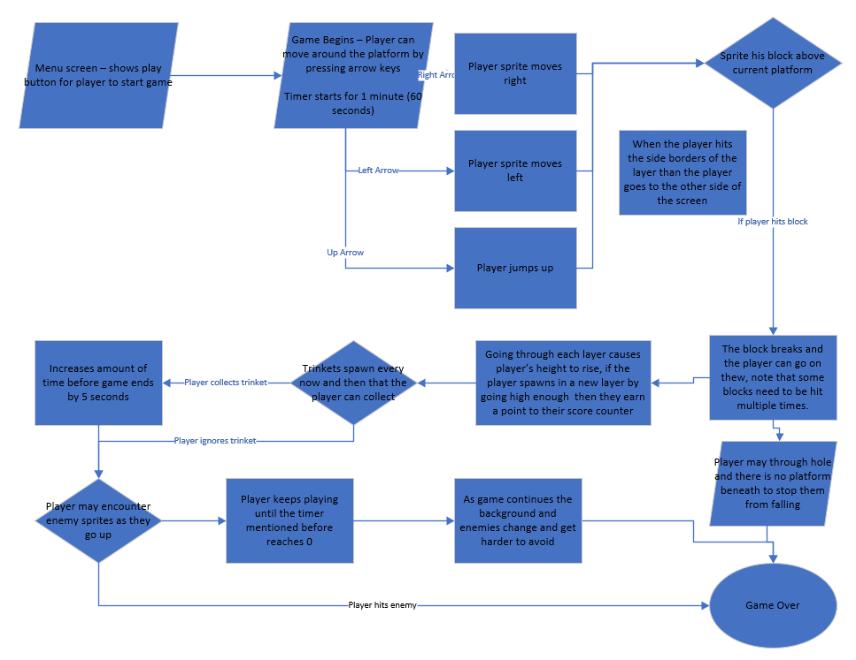
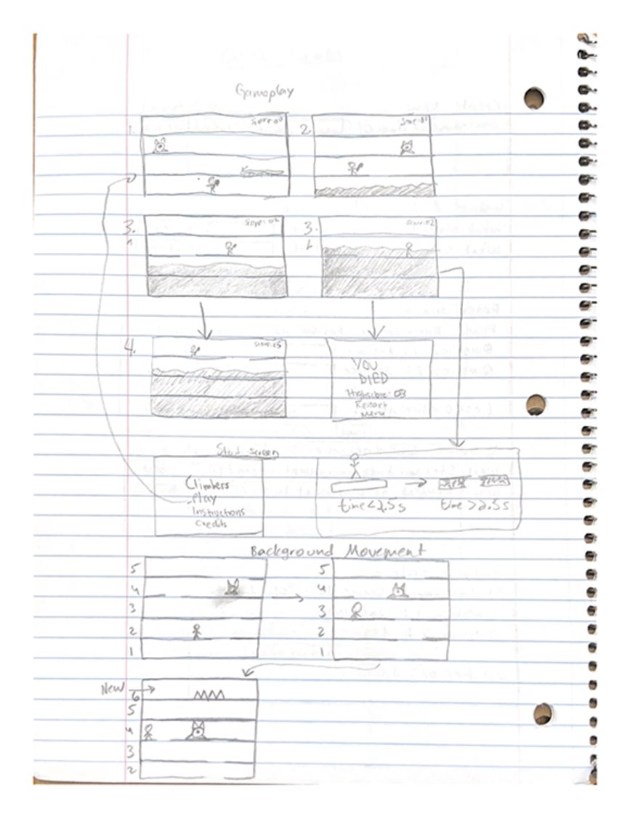
TECHNICAL DESIGN STRUCTURE

Slide 7

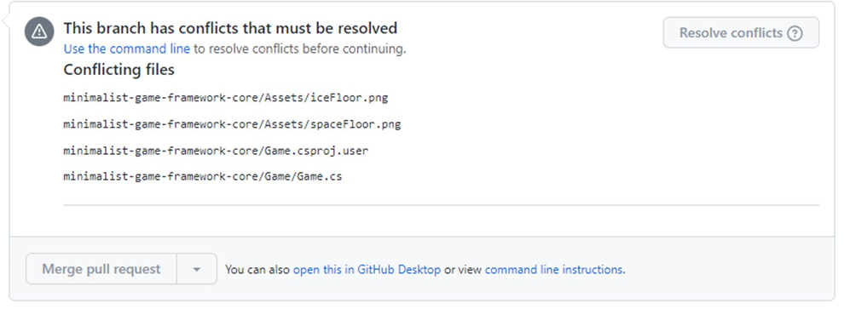
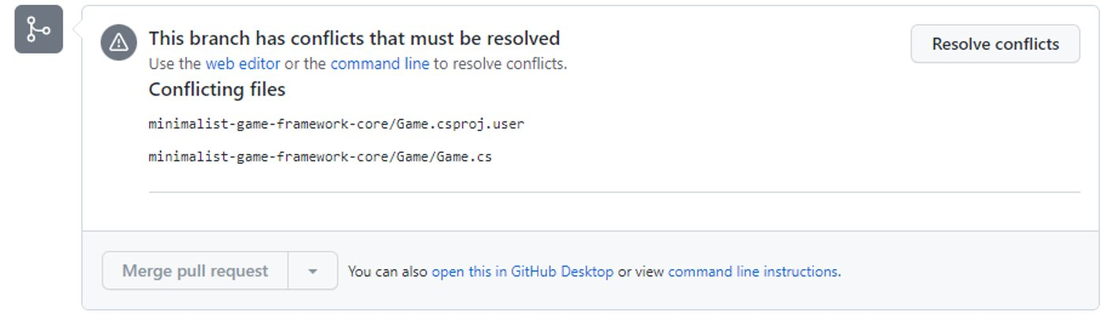
Biggest Challenge
GitHub Merge Conflicts
Solution: Focused on conflicts immediately

Slide 8
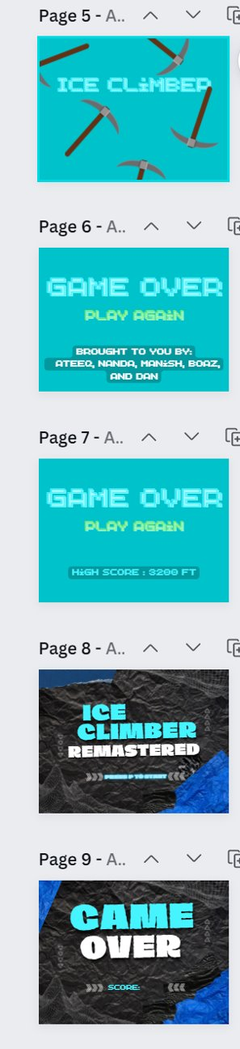
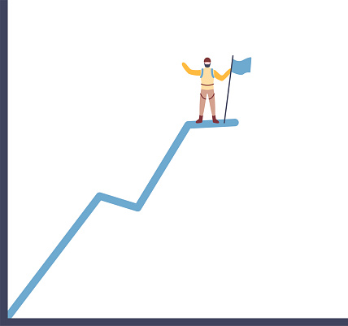
If We Redid Our Project
We would implement the background generation in the physics branch itself to resolve merging
Plan so that the last couple days are on UI since in the end, that's what draws the user in
Keep the main 'hard factor' of the game the same
Work on the aspects of the game that make it hard for the user, and then the sections that make it fun

Slide 9
Group Dynamics
Ateeq: Start screen, End screen, Enemy Mechanics, Sprite
Boaz: Enemy generation and movement, timer
Dan: Random world generation
Manish: Player physics, sound effects
Nanda: Background art, Background scrolling, Background music
Communication: Discord, Teams

Slide 10
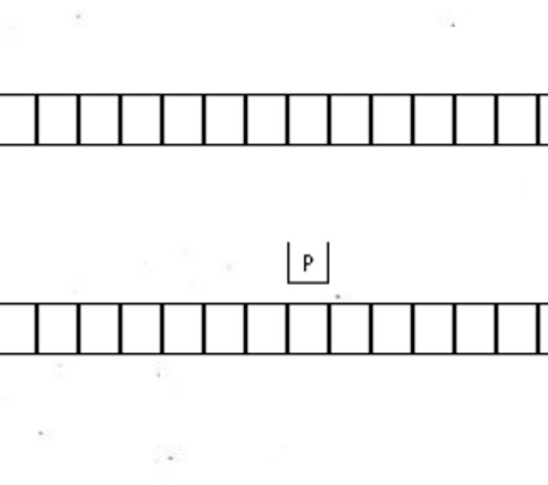
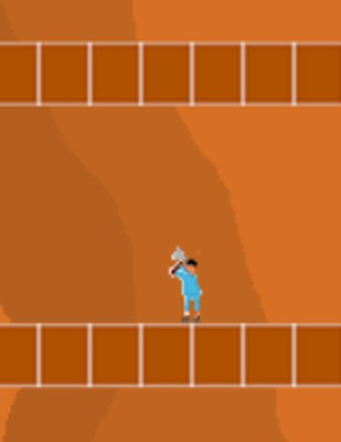
MVL (Most Valuable Lessons) - PART ONE
Lesson 2
Game must have some form of incentivization to make player collect certain objects.
If an object does not offer something necessary for the player to survive, then the player will ignore it and the object is rendered useless
Lesson 1
Teamwork is best when it is optimized for different talents.
I am very good with doing the mechanics of games while Nanda was good at drawing and aesthetics.
My version created the functionality while Nanda made the aesthetics to add at the end

Slide 11
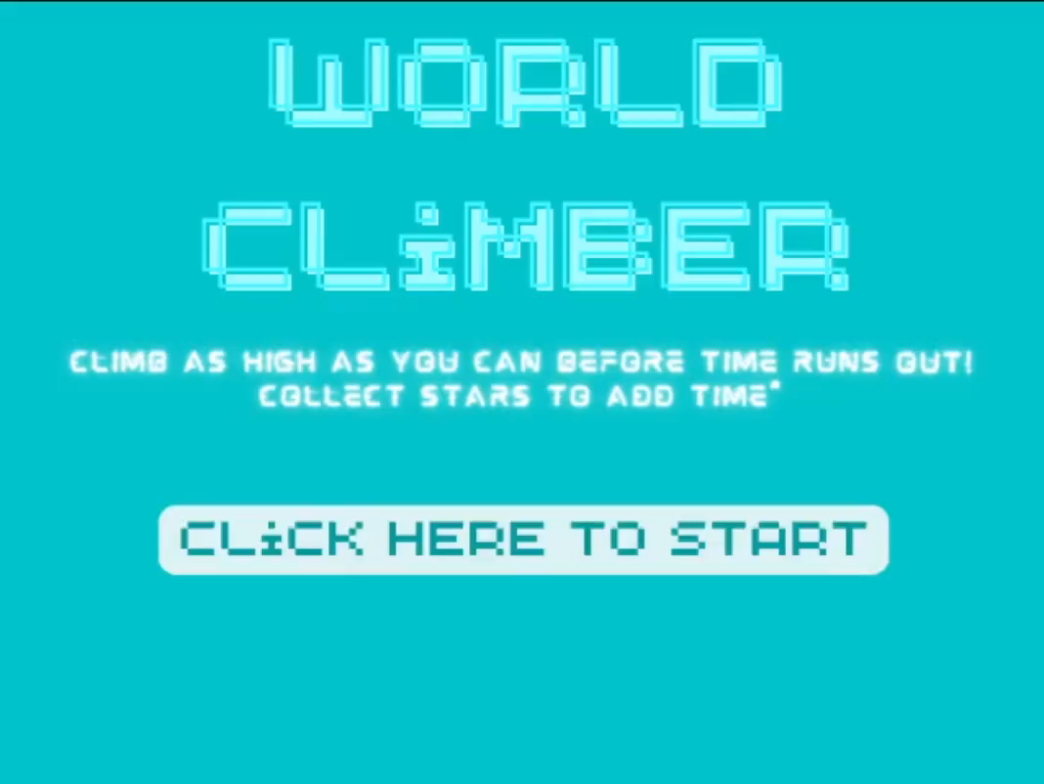
Demo

Slide 12
If we had 1-2-4 more weeks
1 week
Balance the game a little more (Ex: make jumps not as high)
Add animations to the player
2 weeks
Add some type of powerups to the game to make it more engaging
Add a rising lava feature
Add a mode that doesn’t have a timer
4 weeks
Implement a global high score
Have the 2-player option to see who can survive the longest

Slide 13
Pitch and Thanks
New set of features
Groundbreaking enemies
4 different biomes
Endless
- New set of ideas for future​
- Rising Lava
- Timeless mode
- Co-op

